Slide 1


TALKING ABOUT
RISK FOR FUN AND PROFIT
SPOILERS - it’s ALL about the business!
CyberFace says “Wordz matter!”

Slide 2

Who is this jerk?
CRob, n, adj, and v
Pronunciation: U.S. (K-robe)
Over 25 years of Enterprise-class Architecture, Engineering, Operations, and Security experience
Ambassador For Intel Product Assurance and Security – I help manage brand reputation around security
Working Group lead for the OpenSSF Dev Best Practices & Vuln Coordination WGs, FIRST PSIRT TPC WG, and others
Co-Author FIRST PSIRT Services Framework & others
Pirate-enthusiast & hat-owner
CyberFace says “Don’t worry, it’s almost time for the Exceptional Reception, we can all make it through this!”

Slide 3

WHY MANAGING RISK MATTERS
RISK MANAGEMENT TECHNIQUES
01
03
DEFINING RISK
CALL TO ACTION
02
04
AGENDA
WHY
HOW
WAT
WHERE
It may seem strange.
It may make you uncomfortable.
This may seem like a whole new language or way of thinking
It is.
Don’t worry, we’ll all get through this together.

Slide 4
WHY MANAGING RISK MATTERS
01
What’s the worst that could happen?
CyberFace says “We should ONLY focus on things that matter!”

Slide 5

WE ARE OUR CUSTOMER’S SUPPLY CHAIN
As a supplier of goods or services, we affect our customers with delays in opertations and remediation (THEIR compliance). Poor quality in our deliverables impacts THEIR reputation, businesses, and lives. The customers’ projects/initiatives are dependant upon OUR delivery.
Reputation is the most valuable asset an organization possesses. It is hard to earn, It is easy to lose, it is nearly impossible to regain.
CyberFace says “The more effective we are at talking to the business, the more likely we are to achieve our business goals!!”

Slide 6
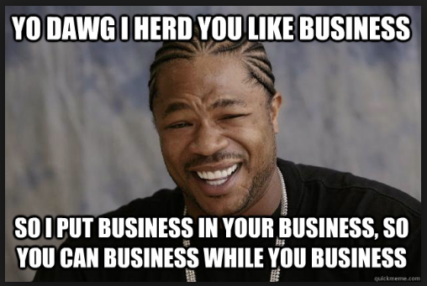
ULTIMATELY, IT IS ALL ABOUT THE BUSINESS
Notes:
Source - https://www.blackenterprise.com/wp-content/blogs.dir/1/files/2014/11/Screen-Shot-2014-11-03-at-10.34.07-AM.png

Slide 7
Risk Management’s purpose is ensure effective & efficient strategy & strategic decisions so that the organization can deliver on their desired outcomes. The primary tool for providing this input to the strategy is risk assessments.
Risk-taking is an intrinsic component of business.
CyberFace says “We all contribute to that risk management culture!”

Slide 8
RISK MANAGEMENT GOALS
Collect all relevant data around the potential problem
Following your org’s Risk Strategy, provide the business calm, trusted advice on possible courses of action
DOCUMENT
RECOMMEND
IDENTIFY
ASSESS
MONITOR
Identify KNOWN risks; explore UNKNOWN risks
Following your RMF, analyze and score the severity of the problems - in BUSINESS TERMS
Set targets for periodic review and monitor progress as old risks are resolved and as new risks evolve

Slide 9
Defining Risk
02
What luminaries like Merriam Webster have to say on this matter...
CyberFace says “It is important to be talking about the same things!”

Slide 10
WAT is RISK?
A risk is a possibility of damage or harm. A risk is described by a threat and a vulnerability. It is often documented as:
RISK = Threat x Vulnerability
A threat is the potential cause of an incident that may result in harm to a system or organization.
A vulnerability is a weakness of software, hardware, or online service that can be exploited has security implications.
It can also be described in terms of Impact and Likelihood
RISK = Likelihood x Impact
FIRST PSIRT Lexicon

Slide 11
Measuring Risk
Qualitative Assessment - relies upon trends, written language, or feelings about the size of a particular issue.
Quantitative Assessment - based off of measurable and observable data

Slide 12
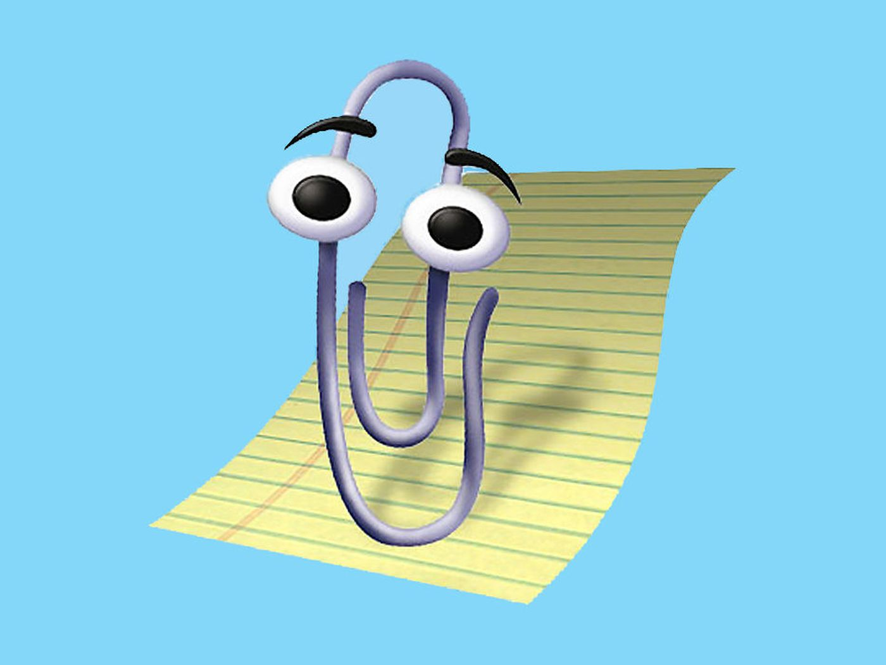
Since you said Quantitative….
Exposure Factor
How much % loss do you expect on your asset?
SLE – Single Loss Expectancy
How much do you think one problem cost?
Asset Value X Exposure Factor = SLE
ARO – Annualized Rate of Occurrence
How often does this bad thing keep happening?
ALE – Annual Loss Expectancy
How much are you expecting to lose each year around this problem?
SLE X ARO = ALE
Clippy says “It looks like you’re trying to measure some risk. Do you want help with that?”

Slide 13
WHAT TYPES OF RISK could you SEE?
Technical | Business | Project
Something impacts technology (typically software vulnerabilities) | Something impacts your ability to execute on your strategy | Something impacts the delivery or execution of a project
Strategic | Tactical | Operational | Compliance
Something impacts your long-term goals | Something impacts your short-term ability to deliver your goals | Something impacts the infrastructure/operations of the organization | Something impacts your ability to execute your legal/regulatory/compliance obligations
Inherent Risk - level of risk prior to mitigation actions. The uncontrolled level of risk
Residual Risk - (current risk) level of risk after applying controls/mitigations.

Slide 14
Boy-howdy, That’s A LOT of Risks
CyberFace says “You don’t know the HALF of it, brother!!”

Slide 15
BUT CROB…..
My lizard brain
Tells me that risks are scary
Scary things are bad...
So isn’t all risk bad?

Slide 16
FALSE!

Slide 17

INTOLERABLE APPETITE
Two more concepts that will be important to us later:
Risk Appetite is the immediate or short-term willingness of an org to undertake an activity that involves risk
Risk appetite is about identifying the optimal level of risk that will achieve the most favourable outcome for the organization
Risk Tolerance represents the range of risk an organization is willing to carry. Sometimes this may be at levels higher than would normally be accepted
CyberFace has a HUNGER for RISK. nom nom nom

Slide 18
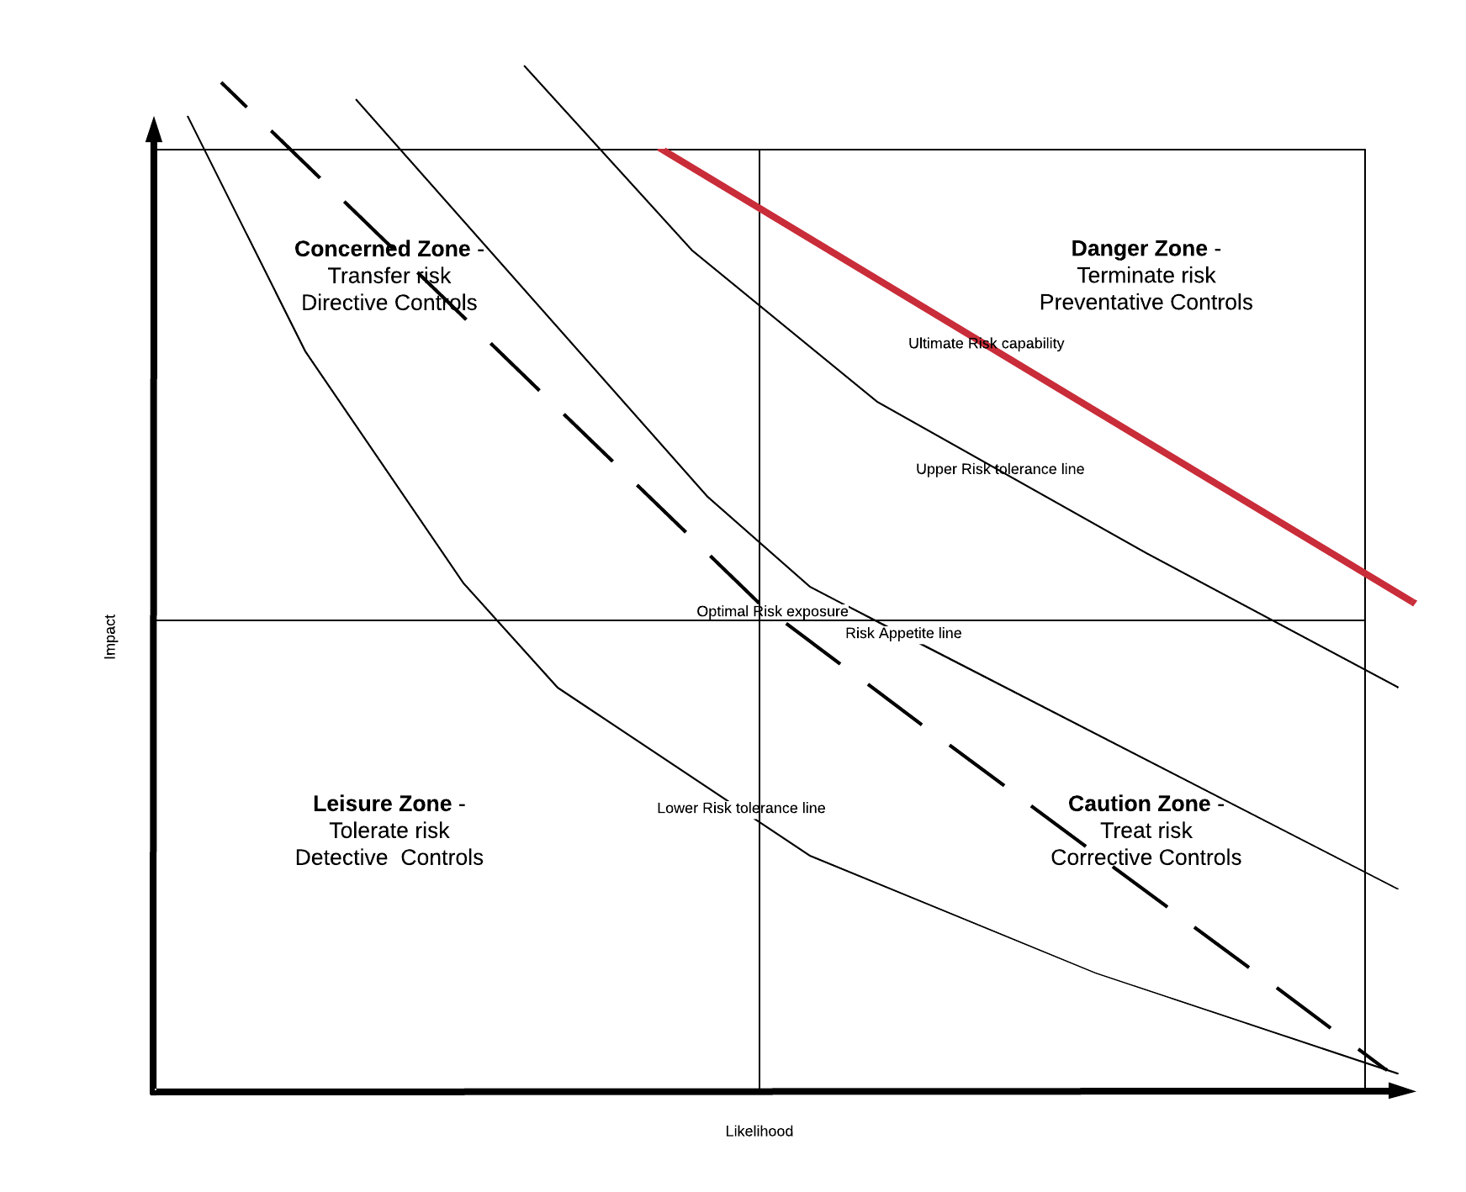
GET IN THE ZONE
Organizations will typically carry enough risk to help them innovate, accelerate, and meet their business objectives (being too conservative will stifle growth or the ability to capitalize on arising opportunities)
The Risk tolerances and appetite of an organization will change over time/economic conditions/market opportunities

Slide 19
RISK MANAGEMENT TECHNIQUES
03
What we can DO about Risk
CyberFace says “Knowing is half the battle!”

Slide 20
WHAT CAN YOU DO WITH A RISK?
Terminate or Eliminate
Treat or Mitigate
Transfer….meh
Tolerate or Accept
This is “The 4 T’s” of Risk Management

Slide 21
HOW DO YOU MANAGE RISK?
….By applying CONTROLS (AKA Mitigations)
Relevant to actions BEFORE an event occurs
Designed to ensure a particular outcome is achieved
PREVENTATIVE
DIRECTIVE
Ex - A Firewall, or SELinux
Ex - A Policy: “Don’t do that!”
DETECTIVE
CORRECTIVE
Relevant to circumstances AFTER an event has occurred
Designed to correct undesirable circumstances or reduce unacceptable risk exposures
Ex - Reviewing Audit logs, an IDS, or network/server scans
Ex - AIDE, or a patch
CyberFace asks “What about COMPENSATING controls?”
Compensating controls are alternatives that can assist in reducing the impact of a risk, oftentimes because a CORRECTIVE control is deemed too expensive.

Slide 22

COOL STORY, BRO
...but HOW do we do that?

Slide 23
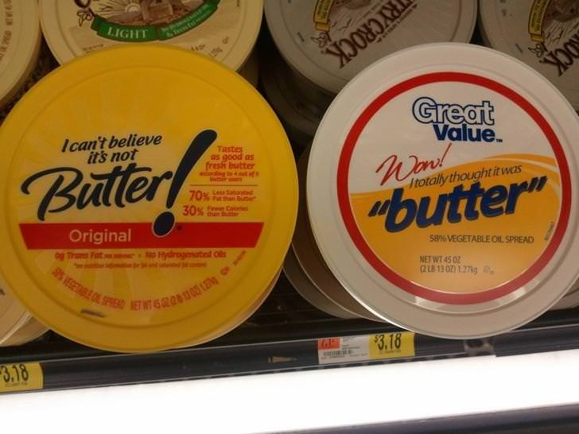
Great Value^{(TM)} Risk Analysis
Likelihood X Impact
How often could this happen x How bad could it be?
Notes:
Image - https://i.chzbgr.com/full/9236456704/h665EF673/meme-about-off-brand-names-i-cant-believe-its-not-butter-to-i-totally-thought-it-was-butter

Slide 24
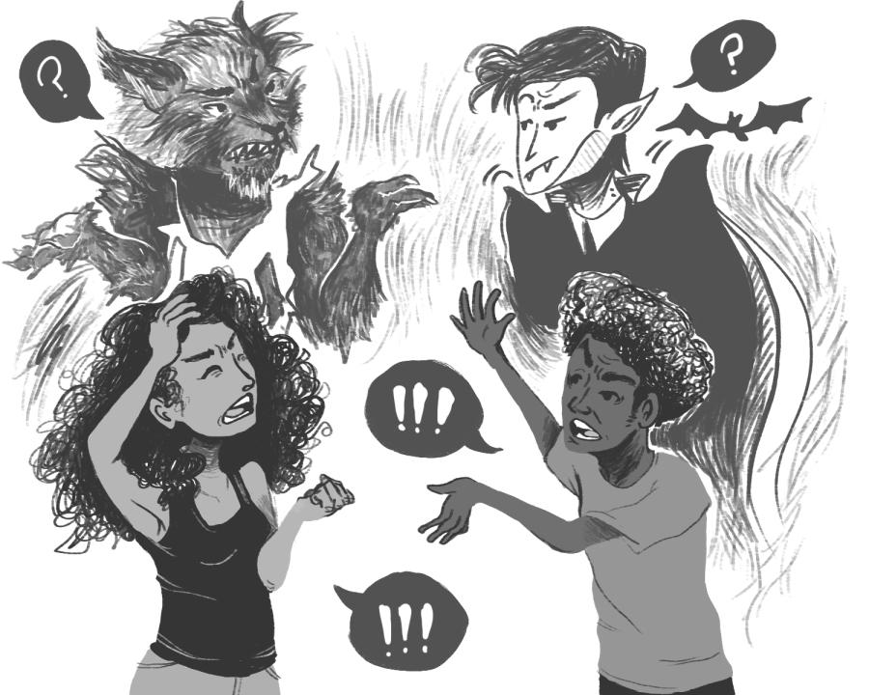
Let’s put this into concepts we all can relate to in our everyday lives
Notes:
Image - https://theeasterner.org/wp-content/uploads/2014/11/WerewolfsandVampires_BW-900x720.jpg

Slide 25

Werewolves – Cuddly friends?
Threat | Likelihood | Impact | Overall Risk
Werewolf | Once every 29.5 days | You are murderfaced | Complete loss of C, I & A
Strengths – speed, agility, heightened senses, and fury. Can break through cement walls, rip people in half, work in groups to bring down their prey, transmit lycanthropy through bites
Weaknesses - Silver is needed to kill a Lycanthrope but most people do not carry a big-assed hunk to defend themselves. Chew toys. The Mailman and/or Amazon guy
Sounds pretty bad if it happens, but it doesn’t happen THAT often

Slide 26




Vampires – Gentleman caller from across the sea
Threat | Likelihood | Impact | Overall Risk
Vampire | ~12hrs every 24hrs | Varies | Varies
Vampire - feeds | ~12hrs every 24hrs | Bad Hickey, tired | C jeopardized, I reduced, A reduced
Vampire - converts | ~12hrs every 24hrs | Hope you enjoy eating flies Renfield | C jeopardized, I greatly reduced, A reduced
Vampire - drains | ~12hrs every 24hrs | You are murderfaced | Complete loss of C,I & A
Twilight | 100% annoying | Ugh. Just STAHP | C complete loss, Complete loss of I, A…probably get some dates
Mileage GREATLY varies. Feeling Lucky?
Strengths – Strength, agility, telepathy to control anyone he’s bitten across the world, weather manipulation, control of nocturnal animals, transforming into a bat, a wolf, and mist, among others.
Weaknesses - Wooden stake in the heart and his head has to be chopped off at the same time, sunlight, crucifixes, garlic, sacramental bread, not being invited into your home, crossing running water and not having home soil.
.

Slide 27

Likelihood & Impact summary
Threat | Likelihood | Impact | Overall Risk
Werewolf | Once every 29.5 days | You are murderfaced | Complete loss of C, I & A
Vampire | ~12hrs every 24hrs | Varies | Varies
Vampire - feeds | ~12hrs every 24hrs | Bad Hickey, tired | C jeopardized, I reduced, A reduced
Vampire - converts | ~12hrs every 24hrs | Hope you enjoy eating flies, Renfield | C jeopardized, I greatly reduced, A reduced
Vampire - drains | ~12hrs every 24hrs | You are murderfaced | Complete loss of C,I & A
Twilight | 100% annoying | Ugh. Just STAHP | C complete loss, Complete loss of I, A…probably get some dates
Cthulhu | ~ Once every millennium | Complete end of reality as you know it | Complete loss of C,I, A
Notes:
Twilight - https://hips.hearstapps.com/hmg-prod.s3.amazonaws.com/images/r9re3w-1600291776.jpg?crop=1.00xw:0.335xh;0,0.101xh&resize=980
Blade2 - https://filmblitz.org/wp-content/uploads/2019/01/blade-ii-678x381.jpg
Dracula - https://womenwriteaboutcomics.com/wp-content/uploads/2017/10/BelaLugosi.jpg
Nosferatu - https://nofspodcast.com/wp-content/uploads/2018/03/nosferatu-anniversary.jpg
Werewolves - https://www.denofgeek.com/wp-content/uploads/2014/10/werewolves-main.jpg?resize=640%2C380
Cthulhu - https://ksr-ugc.imgix.net/assets/024/027/442/31aa2e1255a31091359dac4a90767db9_original.jpg?ixlib=rb-4.0.2&crop=faces&w=1024&h=576&fit=crop&v=1549618448&auto=format&frame=1&q=92&s=31f41edbbe2a42b5091c6688f412462f

Slide 28

HOW ARE WE QUANTIFYING RISKS?
Impossible/No Impact/None
0
1
Very Unlikely/Very Small/Very Low
Remotely Possible/Small-Immaterial/Low
2
3
Somewhat possible/ Important-Material/Moderate
Quite Possible/Serious-Very Material/High
4
5
Very Likely/ Pervasive-Extraordinary/ Critical

Slide 29
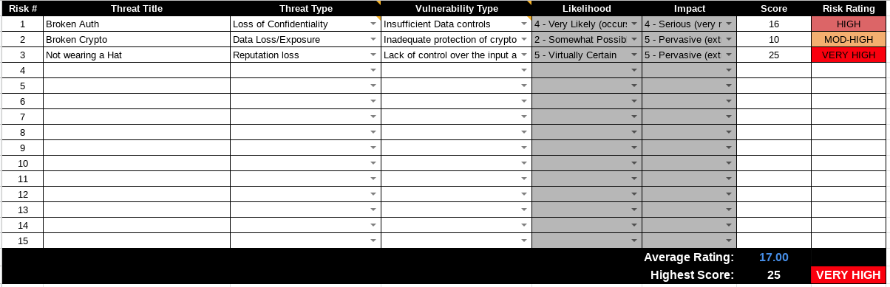
WORK IT OUT
Taking a look at each issue independently first, the Likelihood and Impact are assessed based off of what COULD happen if that risk was realized. The total aggregate risk can be expressed numerically and with standardized words/levels

Slide 30
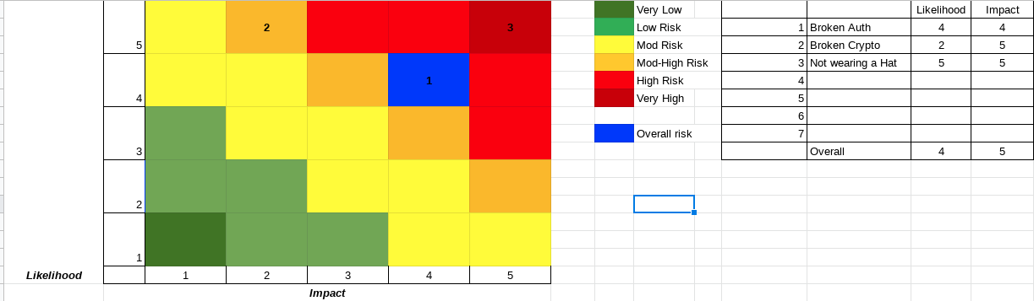
WHAT IS THE MATRIX?
Anyone Catch CRob’s screenshot mess-up?
Since we rated our Risk with both Likelihood and Impact, we can plot it on ….THE RISK MATRIX
CyberFace was wondering if anyone was still awake

Slide 31
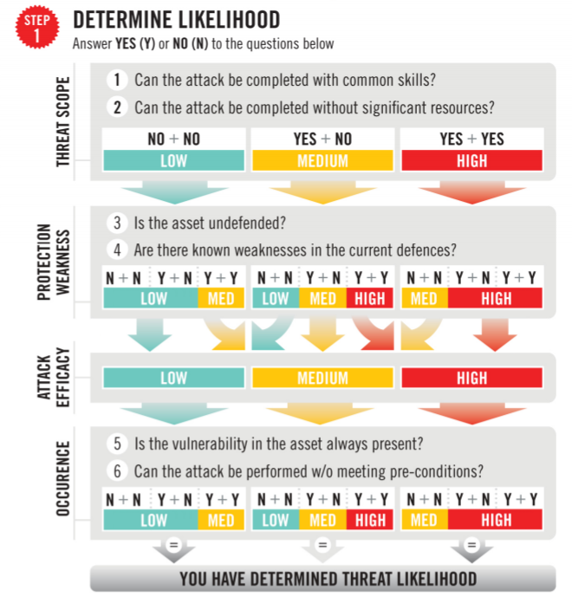
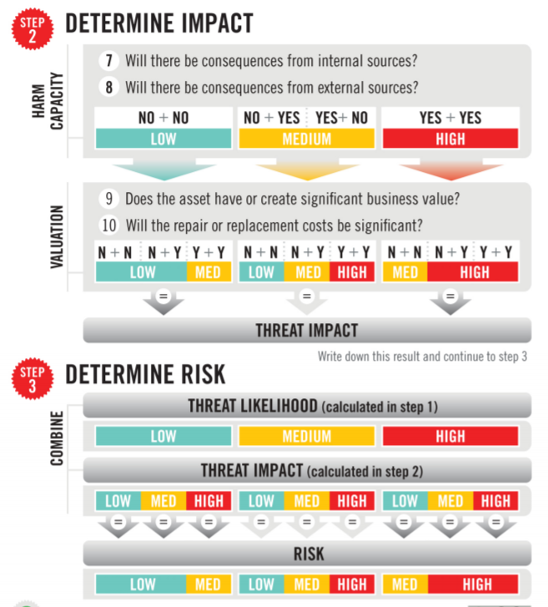
Binary Risk Analysis
Busy? Risk analysis take “too long” to fit into your schedule? Can you say “Yes” or “No”? Do you have time to answer 10 questions about your problem?
Website
Workcard
Web-based Tool

Slide 32
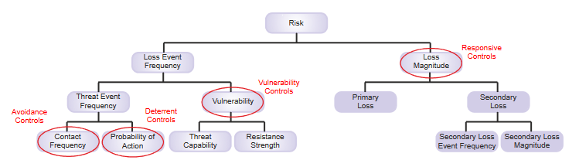

FAIR/OpenFAIR
FAIR is an advanced Qualitative technique.
Requires more effort & data collection, but once organizational data has been collected future assessments are far-easier
Provides accurate FINANCIAL-based impacts, ranges, and probabilities
https://www.opengroup.org/certifications/openfair

Slide 33
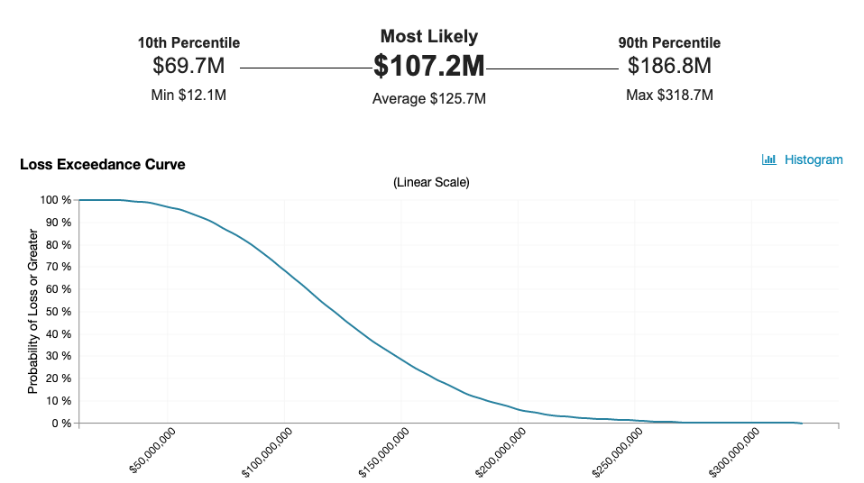
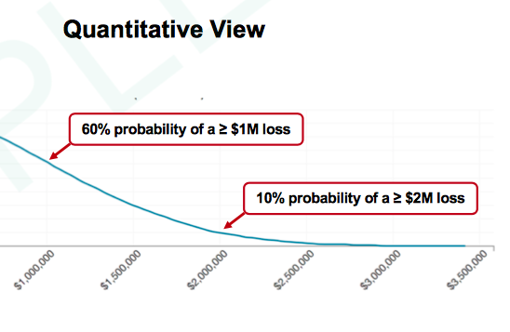
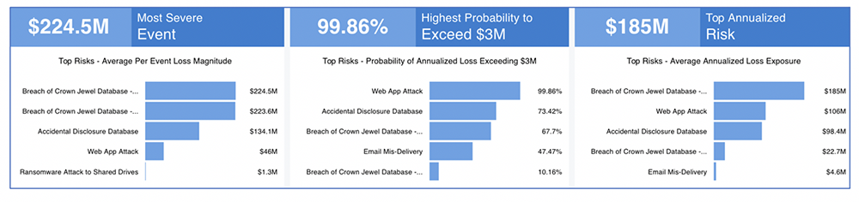

Tools can be Cool!
Cyberface says “I, for one, welcome our new robot...oops I mean tool overlords! Tools can help shape and present your message.”
Notes:
Image - https://blog.vosesoftware.com/fair-style-cybersecurity-risk-assessment-spreadsheet/
https://www.risklens.com/resource-center/blog/three-steps-to-evaluate-security-risks-of-cloud-migration

Slide 34
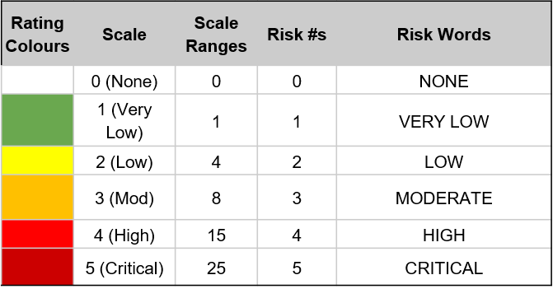
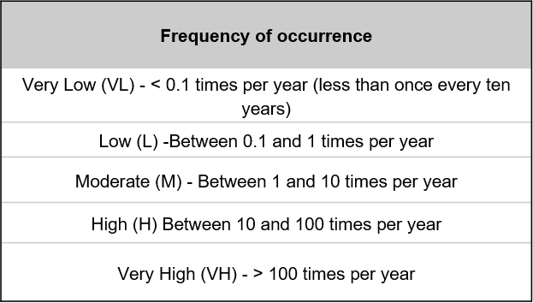
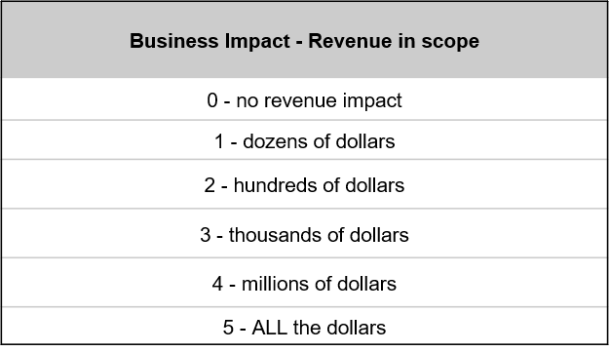
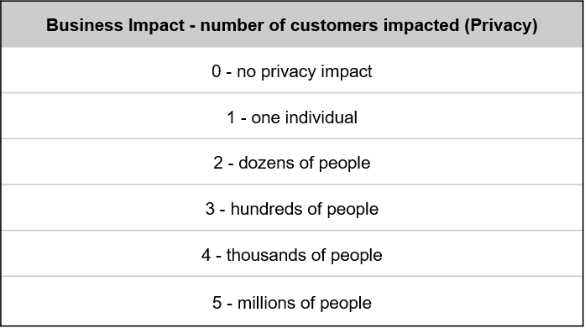
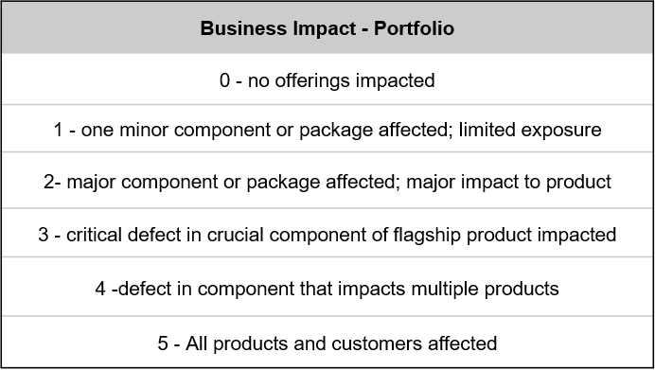

OpenFAIR scales
CyberFace says “Pick the right Impact data for the scenario you’re analyzing.”
Notes:
Image - https://www.vectorstock.com/royalty-free-vector/face-vector-17222552

Slide 35
SHOW ME THE MONEY
Evidence-based reports, like the annual Verizon Data Breach Report can
provide invaluable anecdotal data if you don’t have numbers from your
own incidents
CyberFace says “This is all great, but how can I tie all this together to present it to my decision-makers?”

Slide 36




OPTIONS & IMPACTS
Option A:
What is the first things that could happen?
Option B:
What is the other thing that could happen?
Describe the thing briefly
Describe the other thing briefly
Pros
Explain what is done with Option A simply – who is doing what?
Explain what is done with Option B simply – who is doing what?
Pros
Cons
Pros
Explain the good things that come from this path
Explain the good things that come from this path
Cons
Cons
Explain the negative things that could come from this path
Explain the negative things that could come from this path
Cyberface says “Using O&I helps you lay out the good and bad things that could/will happen for any choice or risk that lays before you so that business leaders can make their decision on which course to pursue.”
Notes:
Image - https://image.shutterstock.com/image-vector/artificial-intelligence-deep-machine-learning-600w-1621762054.jpg

Slide 37

SBAR
Situation
Background
Assessment
Recommendation
What is the problem?
What has been done/How did we get here?
What are the risks caused by the problem?
What should be done to fix the problem?
Cyberface says “SBAR helps to defuse early derailing of your presentation by preempting questions, showing a summary of the problem, your analysis, and a proposed solution right at the beginning.”
Notes:
Image - https://image.shutterstock.com/image-vector/face-recognition-facial-system-concept-600w-1329123827.jpg

Slide 38

FIRM
FINANCIAL
INFRASTRUCTURE
REPUTATION
MARKET
FIRM is a method to articulate risks. It divides problems into four categories:
Is there an impact to our profitability or expenses?
Is there an impact to our core business/ processes / tooling?
Would this impact customer desire / retention?
Would this affect the level of customer trade / expenditure / our market-share?
Cyberface says “You need to frame the conversation with leadership in terms they know and care about!”

Slide 39
CALL TO ACTION
04
Actions Items ALL AROUND!
CyberFace says “I must not fear. Fear is the mindkiller that brings total oblivion…”

Slide 40
CHOOSE YOUR WORDS WISELY
Thinking about the fact that in 2021 and beyond it is likely that your customers will predominantly be BUSINESS/GENERALIST-style users. You need to adjust your language both externally as well as internally
CyberFace says “No business person cares if the muffler bearings on the dynamic flux capacitor are progressively failing in a cascading spiral on non-binary kubernetes software-defined networks.” Just say “Availability for our Core Processing System is compromised.” The End.”

Slide 41
BE FIRM
Using FIRM to focus our language and express things in more business-like language we will be more effective in transmitting our information about the choices that lay ahead for the business.
What are the possible FINANCIAL consequences?
This problem could cause us to spend $1million dollars to correct
What are the possible INFRASTRUCTURE consequences?
Lack of logs means that the we would not know if build pipeline integrity was compromised which could impact our audit and have $42mil implications for fines
What are the possible REPUTATIONAL consequences?
If we are seen as untrustworthy or negligent, this could impact our ability to influence upstream code commits, thus impacting our ability to meet new FINTECH customer PCI Requirements which could negatively impact our stock price.
What are the possible MARKET consequences?
If our software can not meet customer security requirements will will not be able to execute on being the “open hybrid cloud thought leader”, which could impact $400mil in revenue for Q1

Slide 42
WRAPPING IT ALL UP
FOCUS
COMMUNICATE
On understanding your business and areas/processes that will incur greater risks
With all involved stakeholders using appropriate language
EVALUATE
ESCALATE
Using standard criteria and language, understand the severity and scope of the risks found
Manage risk at your level, escalate larger-scope problems

Slide 43
You ARE your brand
Every customer interaction is an opportunity to either improve or take away from that brand

Slide 44





THANKS!
Do you have any questions?
CRob_at_Intel_dot_com
@SecurityCRob
https://github.com/SecurityCRob
https://www.youtube.com/c/SecurityUnhappyHour
CyberFace says “This isn’t the end, this is only the BEGINNING! (mwahaha)”

Slide 45
Resources
Hopkin, Paul. Fundamentals of Risk Management (5th ed.). Kogan Page, 2018.
Freund, Jack and Jack Jones. Measuring and Managing Information Risk - a FAIR approach.Elsvier, 2015.
Hubbard, Douglas W. and Richard Seirsen. How to Measure Anything in Cybersecurity Risk. Wiley, 2016.
Landoll, Douglas J. The Security Risk Assessment Handbook. Auerback Publications, 2006.
Talabis, Mark Ryan M. and Jason L. Martin. Information Security Risk Assessment Toolkit. Syngress, 2013.
Allen, Brian and Rachelle Loyear. Enterprise Security Risk Management. Rothstein Associates, 2019.
DeMarco, Tom and Timothy Lister. Waltzing with Bears - Managing Risk on Software Projects. Dorset House Publishing, 2003.
Binary Risk Assessment – https://binary.protect.io/workcard.pdf
OpenFAIR - https://www.opengroup.org/certifications/openfair

Slide 46
DICTIONARY
Risk - a possibility of damage or harm.
Threat - a circumstance that could have an adverse affect on an asset. Threats can come from people, technical, or environmental factors.
Asset - could be many things, including a piece of software, a server, or data.
Vulnerability - is a weakness or absence of a safeguard in an asset that provides a higher potential or frequency of a threat occurring.
Likelihood or Probability - how sure the assessor is that an event occurring
Impact - the measurement of what possible costs would be incurred if that event did happen. The Cost could be financial (and typically is what is focused on), but impacts to personnel, morale, organization effectiveness, or delays in delivery times lines are other examples.

